Slide 2
Africa

Slide 3
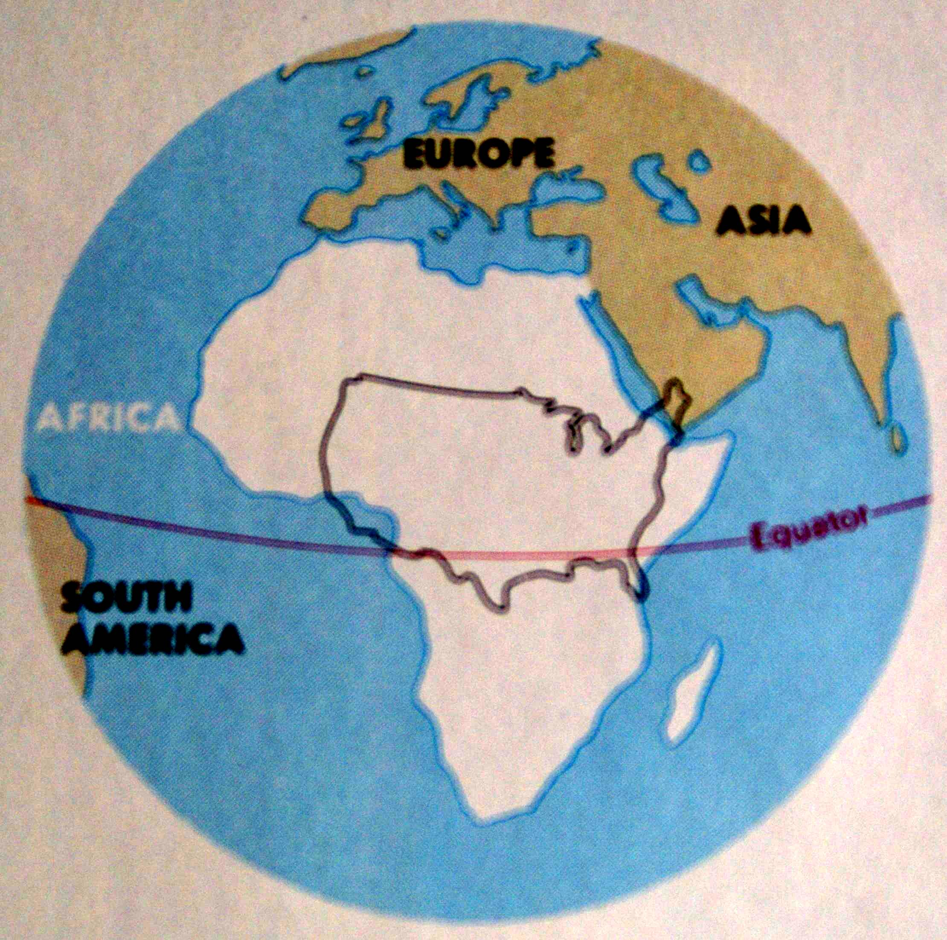
AFRICA
FOUR USA MAINLANDS CAN FIT INTO THE AFRICAN CONTINENT.

Slide 4
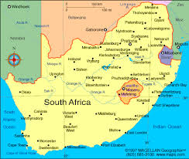
Where is South Africa, Zimbabwe, and Mozambique?

Slide 5
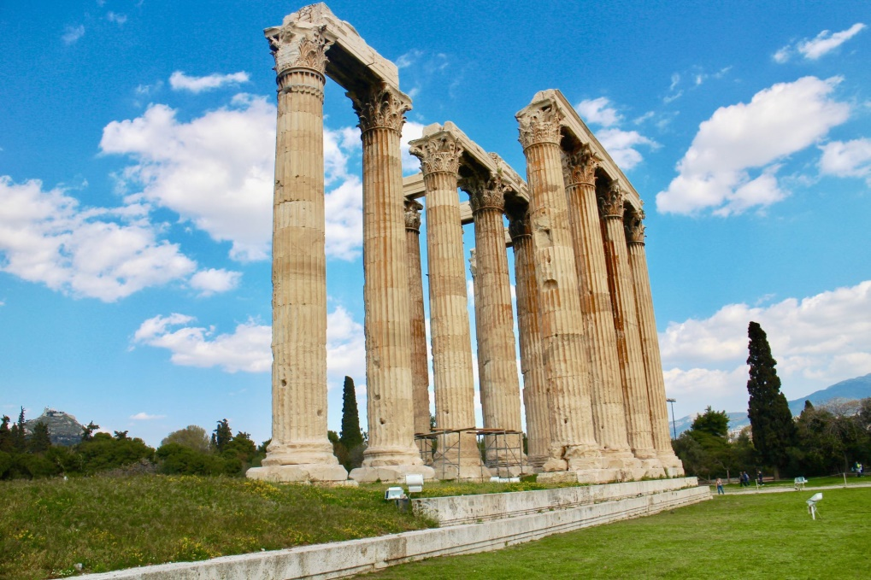
Building Pillars in the Church
2015-2017

Slide 6
Building Pillars in the church
1 Ti 3:15 — 15 but in case I am delayed, I write so that you will know how one ought to conduct himself in the household of God, which is the church of the living God, the pillar and support of the truth.

Slide 7
Building Pillars in the church
Ga 2:9 — 9 and recognizing the grace that had been given to me, James and Cephas and John, who were reputed to be pillars, gave to me and Barnabas the right hand of fellowship, so that we might go to the Gentiles and they to the circumcised.

Slide 8
Building Pillars in the church
What does it take to build pillars in the church?

Slide 9
Pillars Do not Begin as Pillars
2 Ti 3:15 — 15 and that from childhood you have known the sacred writings which are able to give you the wisdom that leads to salvation through faith which is in Christ Jesus.

Slide 10
Pillars Do not Begin as Pillars
Few or no children’s or young people’s classes
Young people are the future church
Introducing and re-introducing young people classes
Gadabi, Polokwane

Slide 11
Pillars Do not Begin as Pillars
5 day classes during school vacation

Slide 12
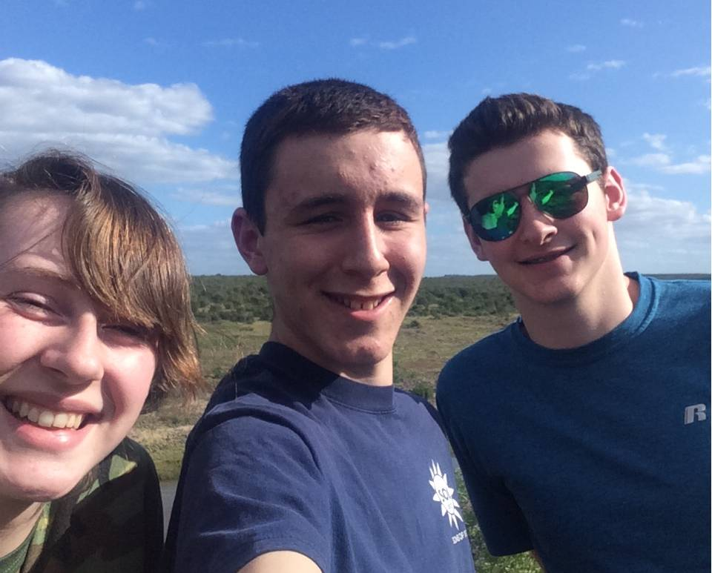
Pillars Do not Begin as Pillars
Using Young men and women to teach by example
Abi, Sean, Josh

Slide 13
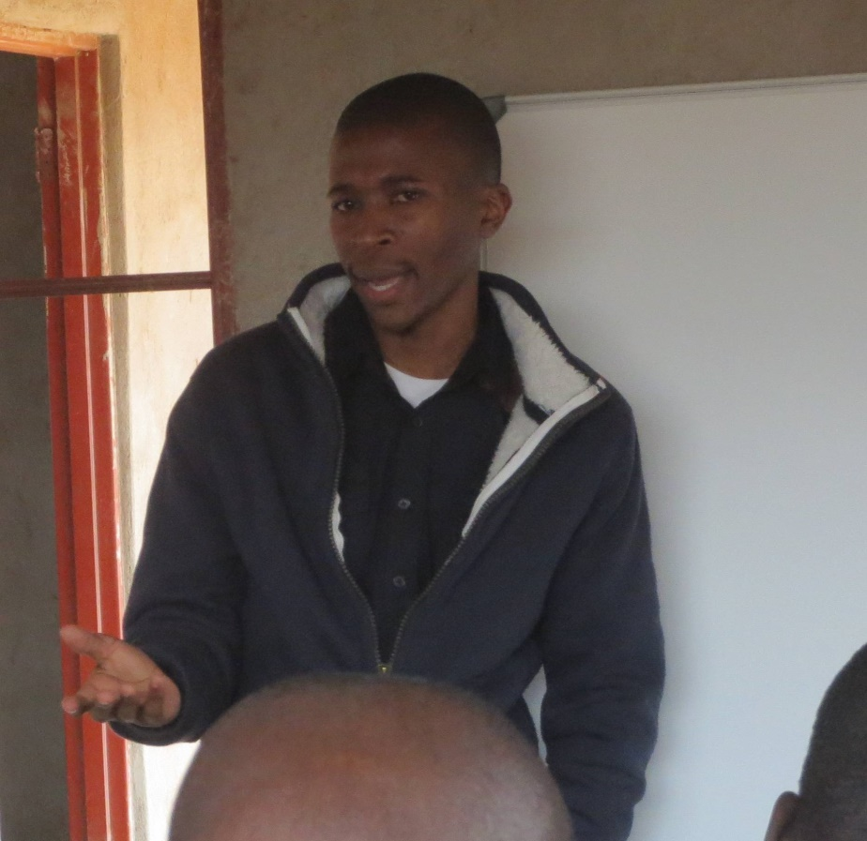
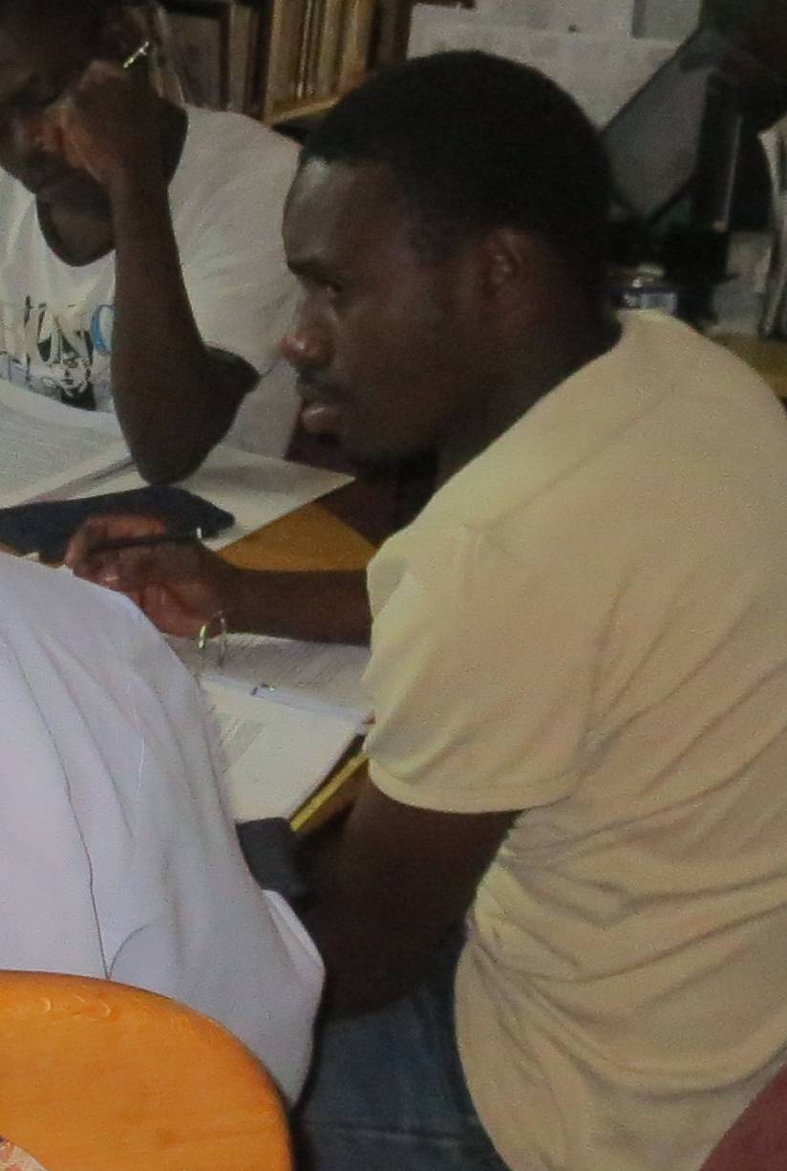
Pillars Do not Begin as Pillars
Using Young men and women to teach by example
Venda young men Mbavhalelo & Ishmael

Slide 14
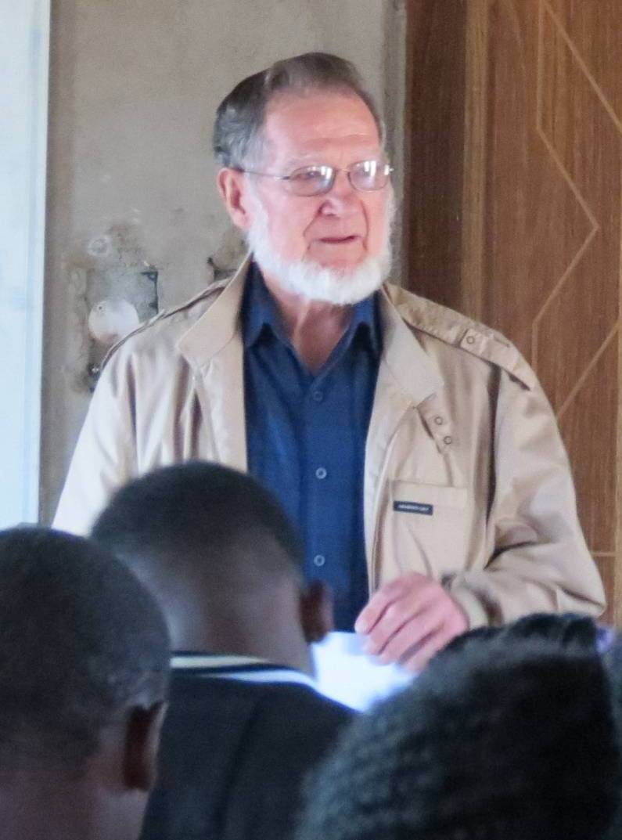
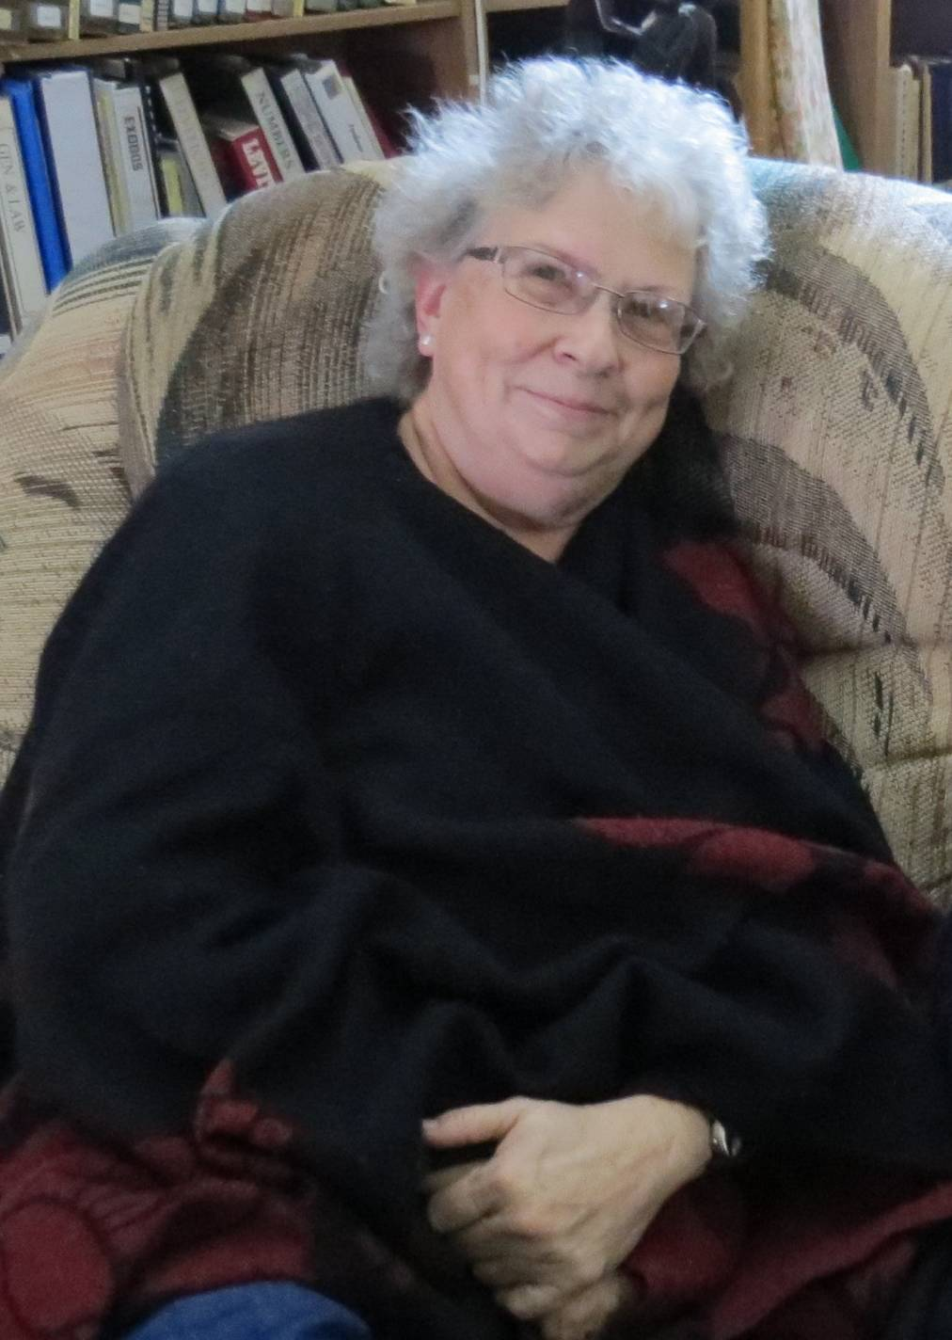
Pillars Do not Begin as Pillars
By using visiting teachers
The Kendall-Balls

Slide 15
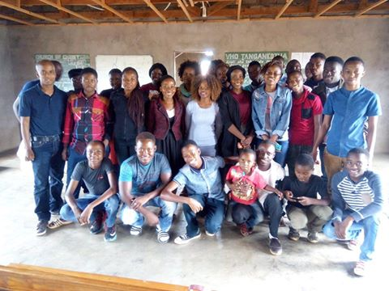
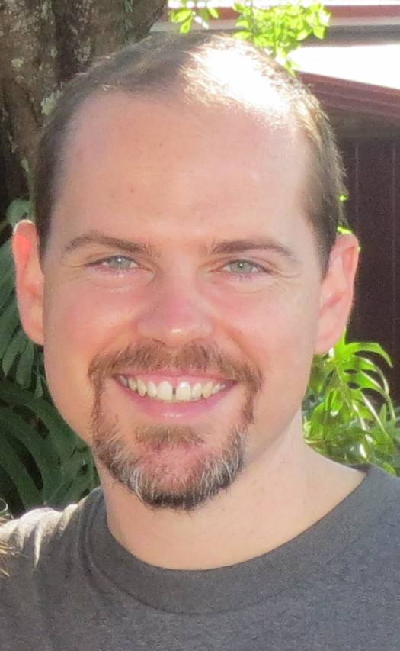
Pillars Do not Begin as Pillars
By using visiting teachers
Joel Williams

Slide 16
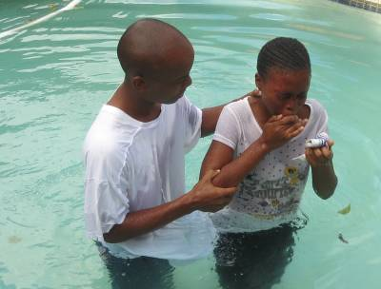
Pillars Do not Begin as Pillars
Building pillars in the church begins here by helping young people to see the importance of following God.

Slide 17
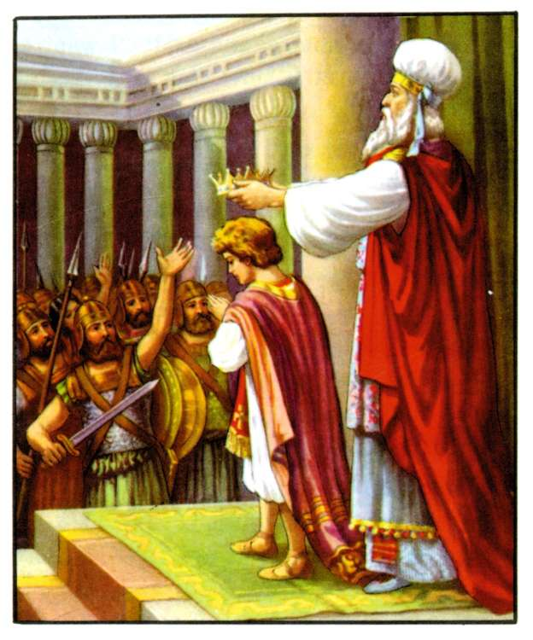
Pillars Do not Begin as Pillars
7 year old Joash -2 Chr 23:13; 2 kgs 23:3.

Slide 18
Pillars Do not Begin as Pillars
We need to build a hunger for the Word
1 Pe 2:2 like newborn babies, long for the pure milk of the word, so that by it you may grow in respect to salvation,

Slide 19
PILLARS NEED TO BE SHAPED AND STRENGTHENED

Slide 20
PILLARS NEED SHAPED AND STRENGTHENED
Ps 144:12 — 12 Let our sons in their youth be as grown-up plants,
And our daughters as corner pillars fashioned as for a palace;

Slide 21
PILLARS NEED SHAPED AND STRENGTHENED
1st- Outside encouragement and teaching of the Word.
1 Th 3:2 and we sent Timothy, our brother and God’s fellow worker in the gospel of Christ, to strengthen and encourage you as to your faith,
Ac 15:32 Judas and Silas, also being prophets themselves, encouraged and strengthened the brethren with a lengthy message.

Slide 22
PILLARS NEED SHAPED AND STRENGTHENED
2nd – Our Faith allows the Father to strengthen us
2 Th 3:3 But the Lord is faithful, and He will strengthen and protect you from the evil one.
Col 1:11 strengthened with all power, according to His glorious might, for the attaining of all steadfastness and patience; …

Slide 23
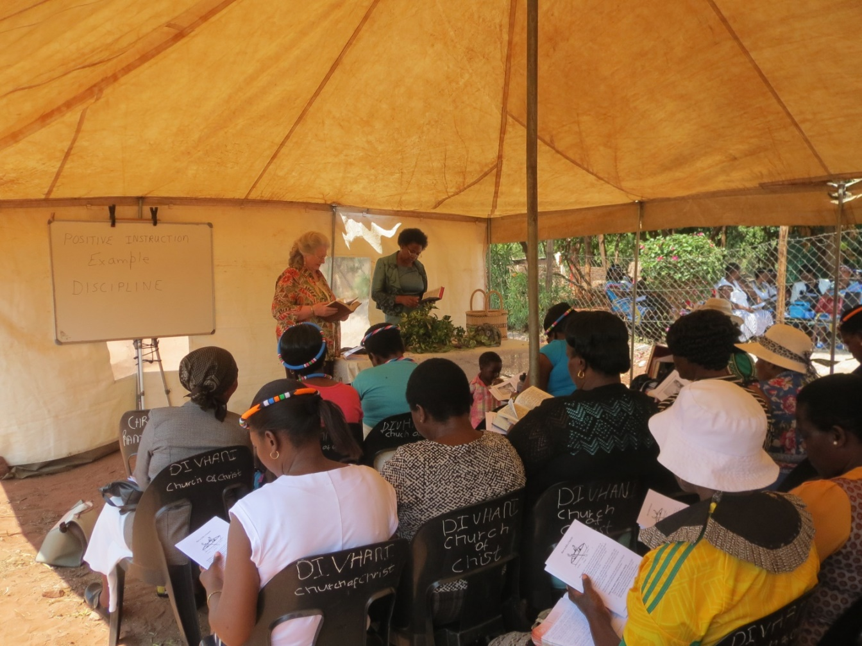
PILLARS NEED SHAPED AND STRENGTHENED
Strength grows from receiving instruction-
Tent meetings and special studies

Slide 24
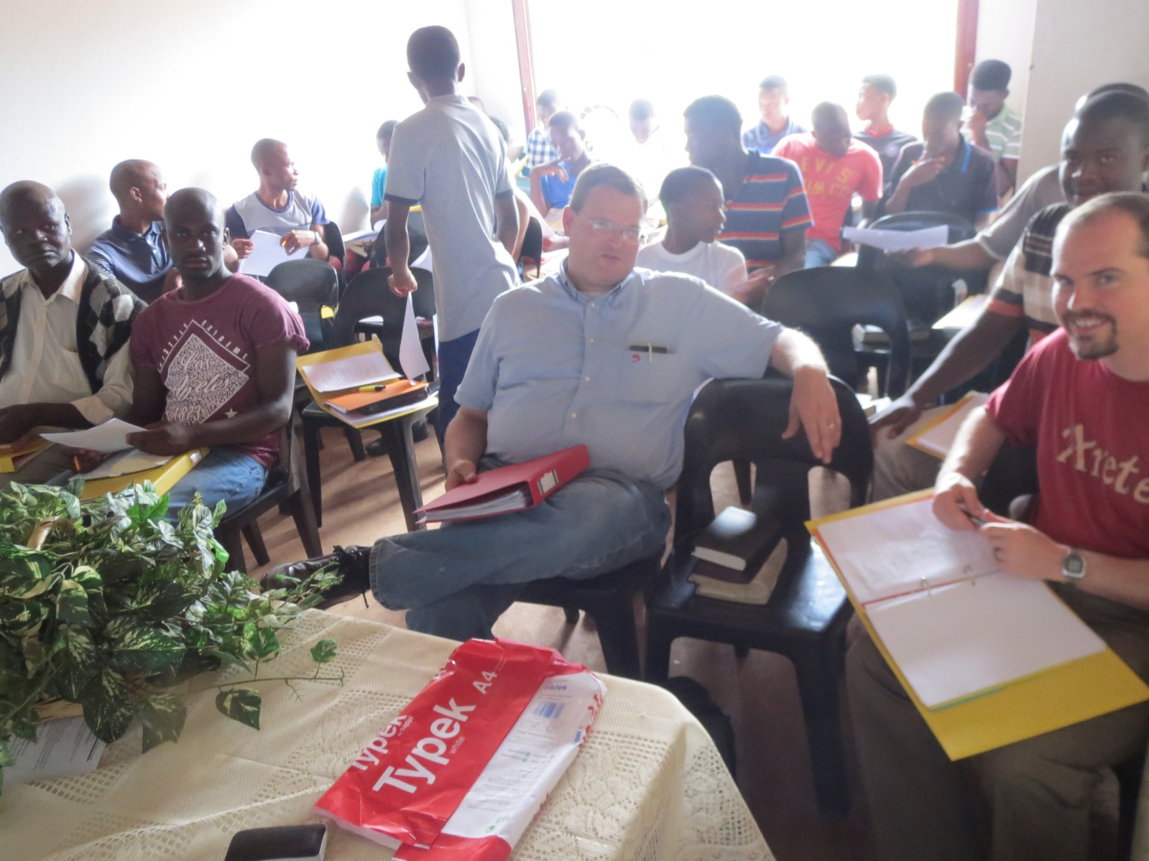
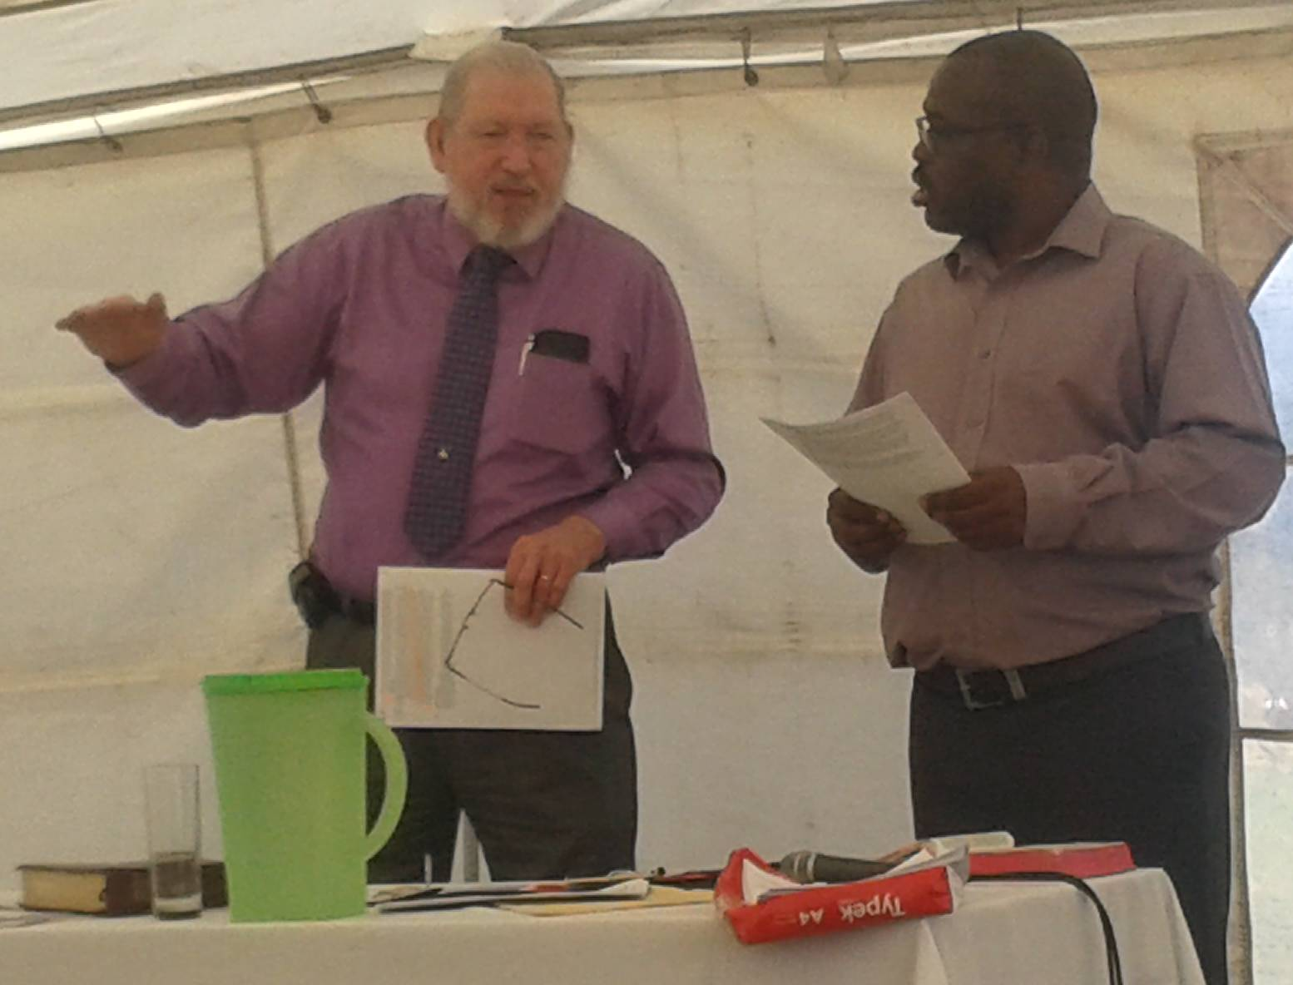
PILLARS NEED SHAPED AND STRENGTHENED
By Lectureships
Preacher training classes

Slide 25
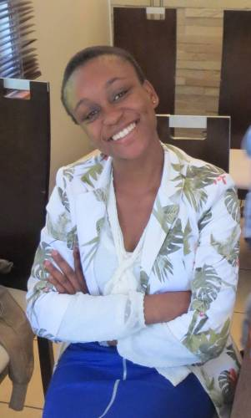
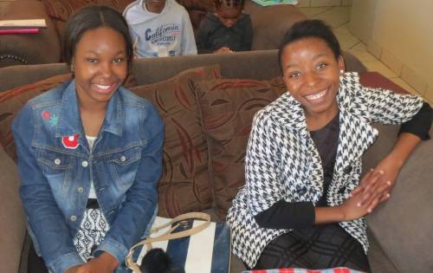
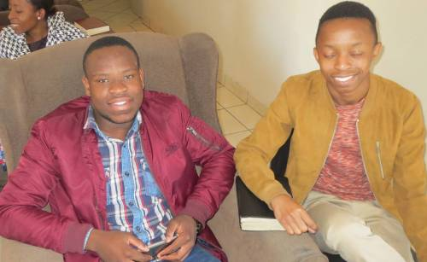
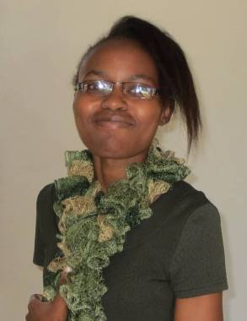
PILLARS NEED SHAPED AND STRENGTHENED
Bible classes designed to meet special needs

Slide 26
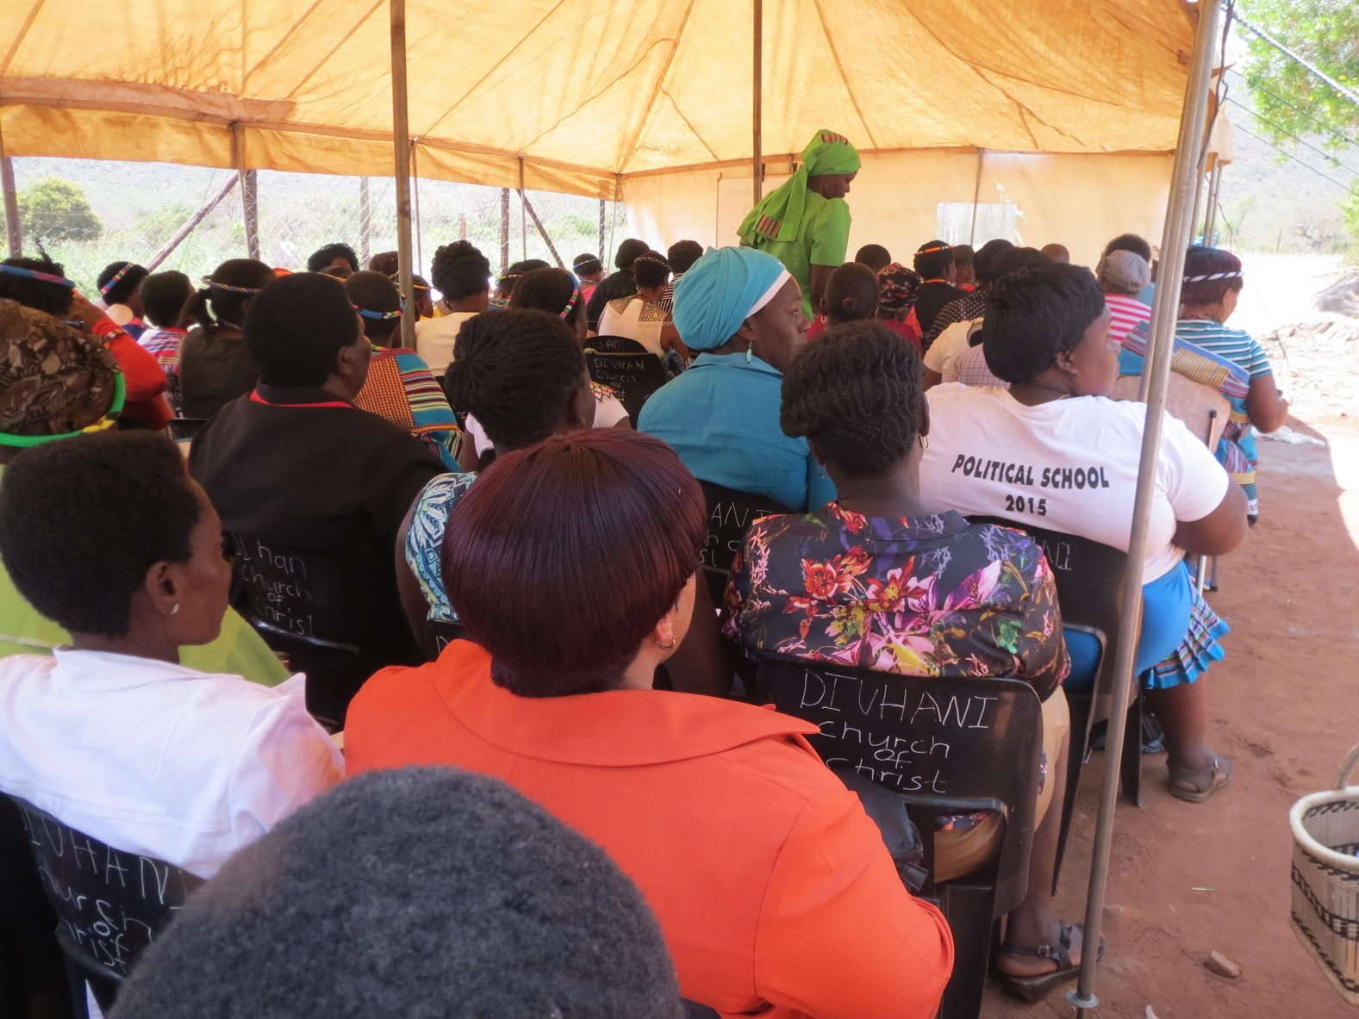
PILLARS NEED SHAPED AND STRENGTHENED
Strength grows from receiving instruction-
To reach out to Others

Slide 27
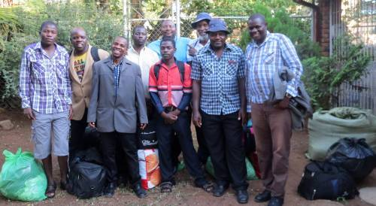
PILLARS NEED SHAPED AND STRENGTHENED
Reaching out to others through:
Relief for Zimbabwe & Mozambique.

Slide 28
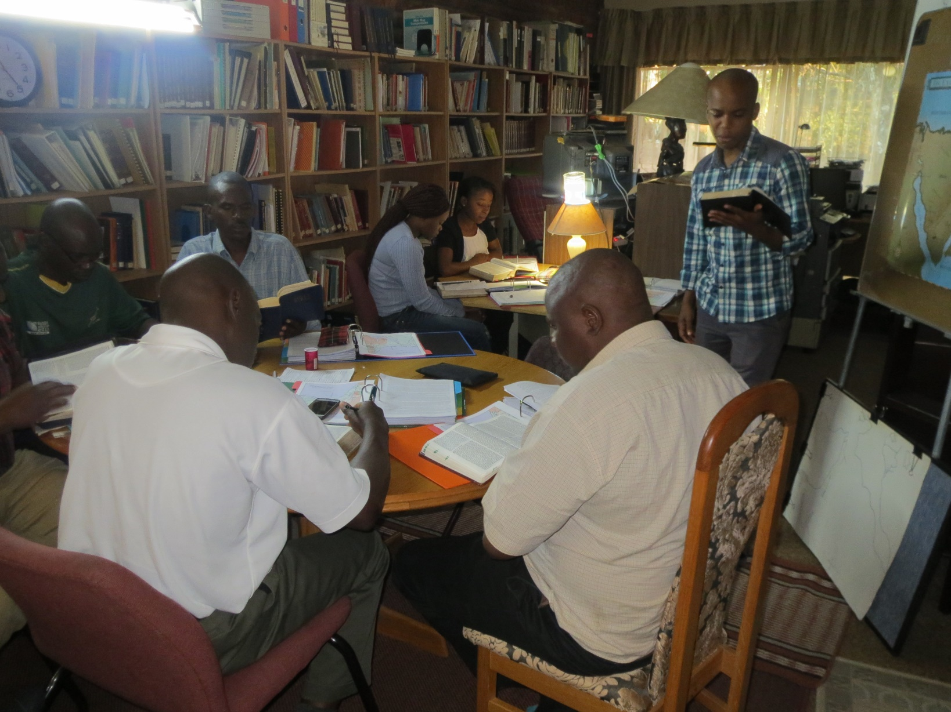
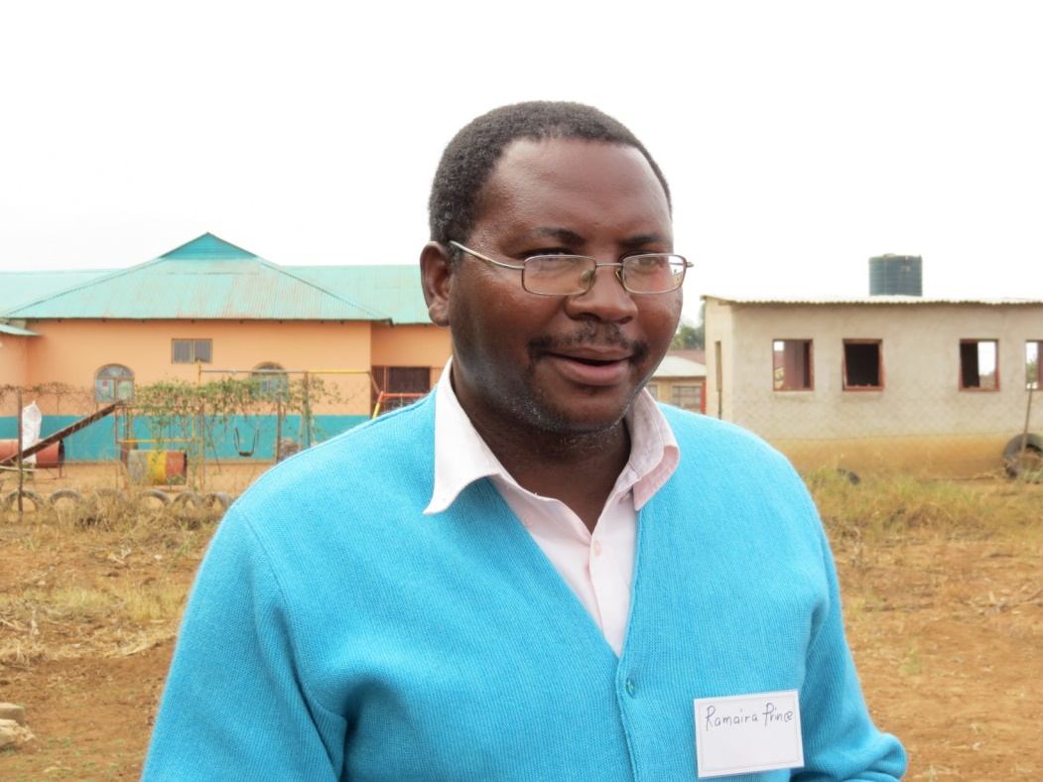
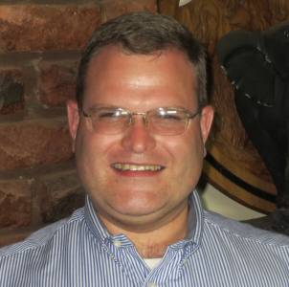
PILLARS NEED SHAPED AND STRENGTHENED
Reaching out to others through:
Encourage support of local men

Slide 29
PILLARS NEED SHAPED AND STRENGTHENED
Reaching out to Others:
Some congregations did not use the opportunity to improve.
Rev. 3:2; Luk 8:14

Slide 30
PILLARS NEED SHAPED AND STRENGTHENED
Re 3:2 — 2 ‘Wake up, and strengthen the things that remain, which were about to die; for I have not found your deeds completed in the sight of My God
Lk 8:14 — 14 “The seed which fell among the thorns, these are the ones who have heard, and as they go on their way they are choked with worries and riches and pleasures of this life, and bring no fruit to maturity.

Slide 31
THE PILLAR MUST BE COMPLETED
Wisdom as an example-
Pr 9:1 — 1 Wisdom has built her house, She has hewn out her seven pillars;

Slide 32
THE PILLAR MUST BE COMPLETED
Jdg 16:29–30 — 29 Samson grasped the two middle pillars on which the house rested, and braced himself against them, the one with his right hand and the other with his left. 30 And Samson said, “Let me die with the Philistines!” And he bent with all his might so that the house fell on the lords and all the people who were in it. ….

Slide 33
THE PILLAR MUST BE COMPLETED
God’s People MUST develop.-Eph 4:13
Eph 4:13 — 13 until we all attain to the unity of the faith, and of the knowledge of the Son of God, to a mature man, to the measure of the stature which belongs to the fullness of Christ.

Slide 34
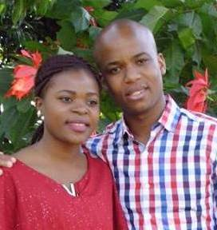
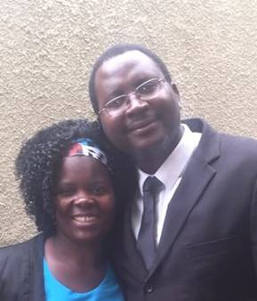
THE PILLAR MUST BE COMPLETED
God’s People MUST develop.-Eph 4:13
Into faithful men and women who can teach the gospel to others

Slide 35
THE PILLAR MUST BE COMPLETED
Use our God-given “gifts.” (Rom12:6-8; 1 Pet 4:10-11)

Slide 36
THE PILLAR MUST BE COMPLETED
Maturity in teaching
Heb 5:12 — 12 For though by this time you ought to be teachers, you have need again for someone to teach you the elementary principles of the oracles of God, and you have come to need milk and not solid food.

Slide 37
THE PILLAR MUST BE COMPLETED
Heb 6:1 — 1 Therefore leaving the elementary teaching about the Christ, let us press on to maturity, not laying again a foundation of repentance from dead works and of faith toward God,

Slide 38
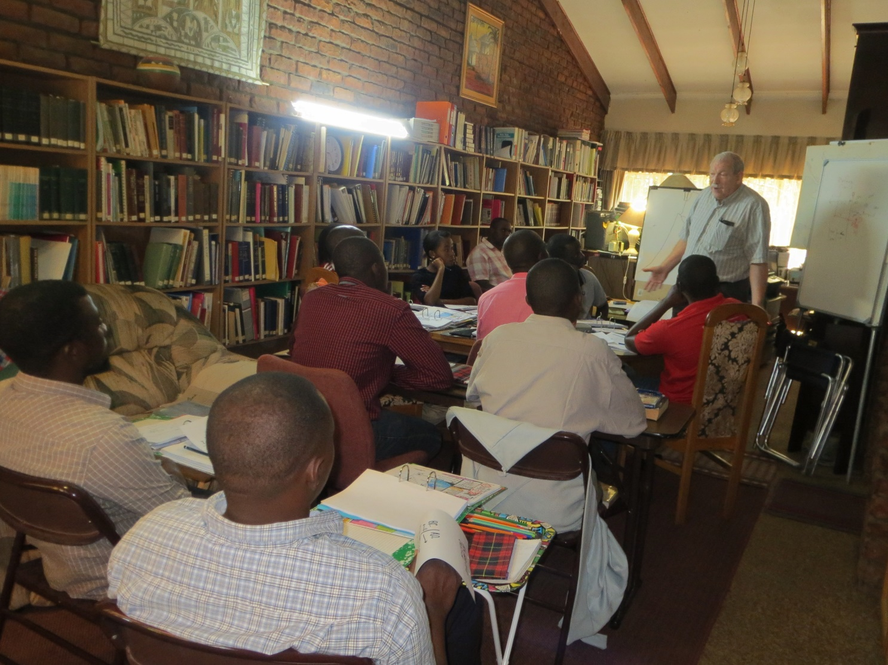
THE PILLAR MUST BE COMPLETED
Maturity in teaching

Slide 39
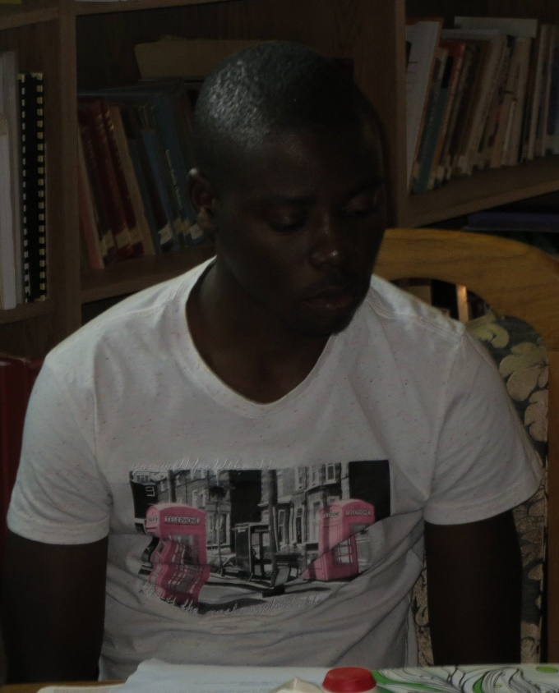
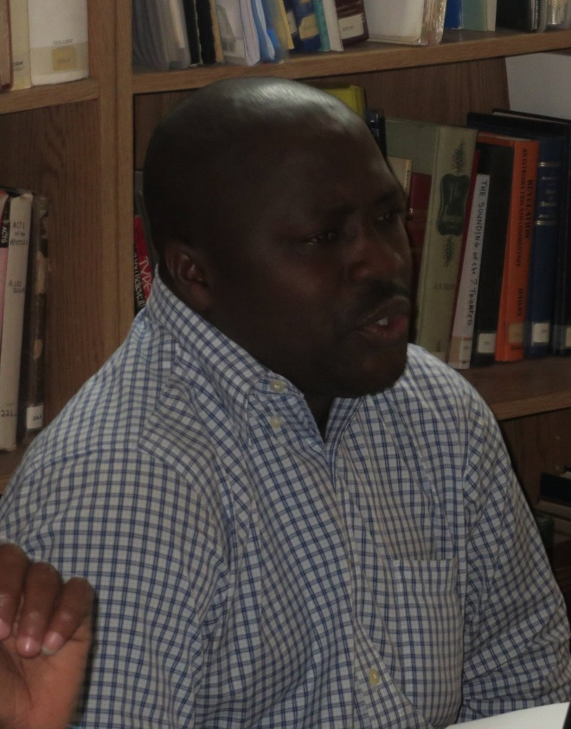
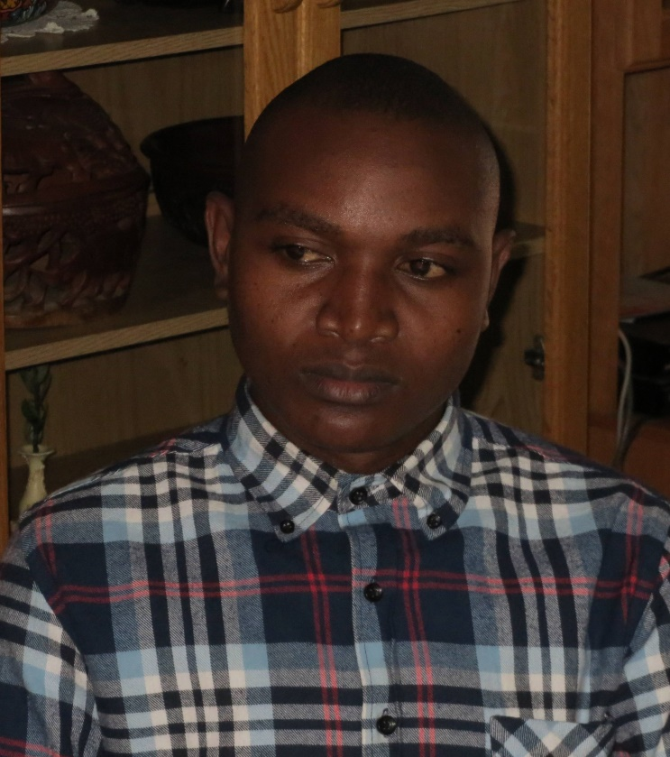
THE PILLAR MUST BE COMPLETED
Mozambican Study
Arao Moses Nelson Franciso

Slide 40
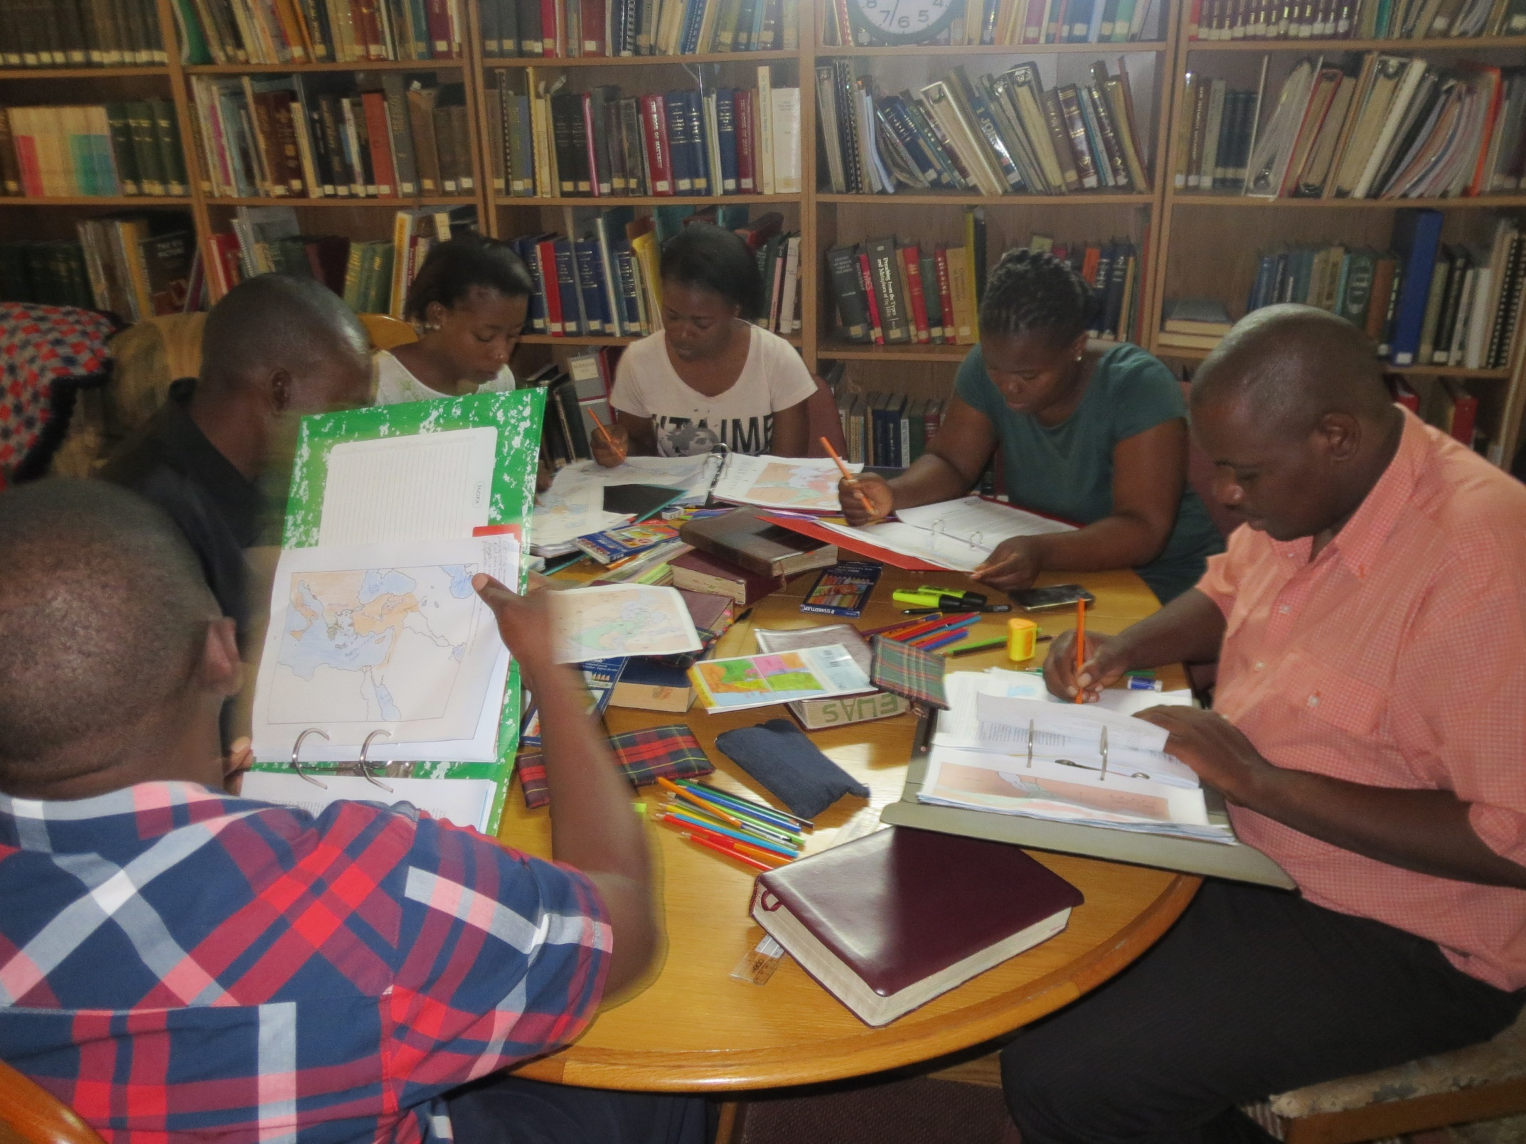
THE PILLAR MUST BE COMPLETED

Slide 41
THE PILLAR MUST BE COMPLETED

Slide 42
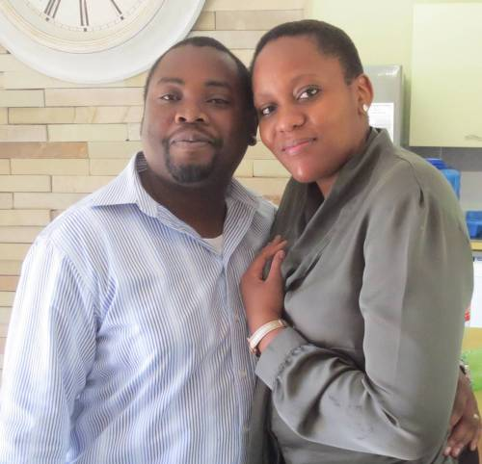
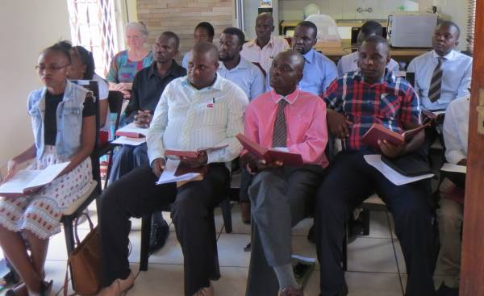
THE PILLAR MUST BE COMPLETED
Starting new congregations
Mulalo (Peace) & Faith

Slide 43
CONCLUSION
Do we stand as pillars in this church?

Slide 44
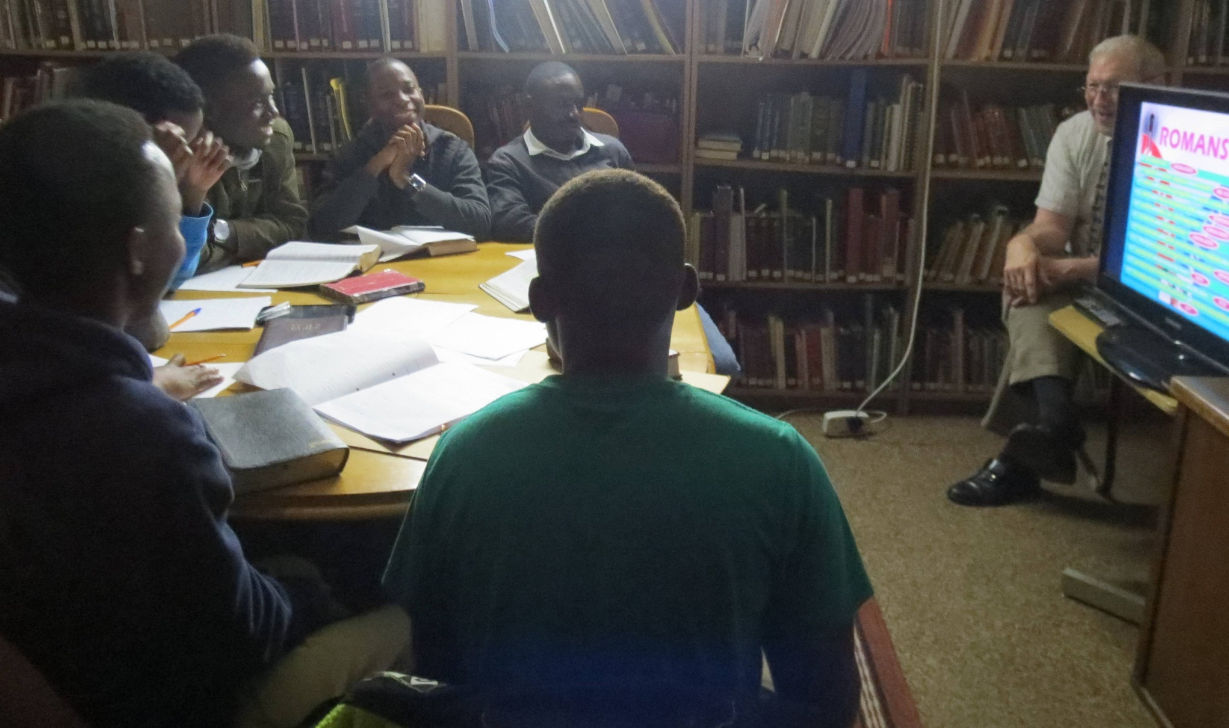
CONCLUSION
Are we helping young people to develop?

Slide 45
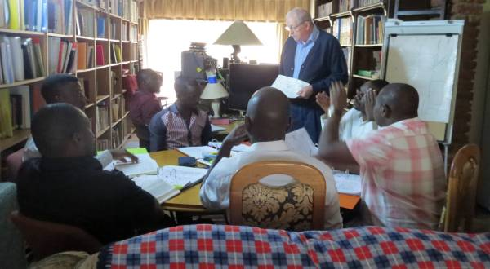
CONCLUSION
Are we bearing up under the load?

Slide 46
CONCLUSION
Example in Jer. 1:18
Be a pillar of iron!

